Slide 1
Persons Web Registry
A web based registry that can be utilized in different generic use cases in the health sector (for instance - health facilities, people, institutions, schools, ).

Slide 2
Description/Features
The Persons Web Registry is an API that allows for a person data to be recorded, and can be used in different generic use cases in health sector.
Each person entity is mapped to three tables in a database capturing the person’s bio data, next of kin details and clinic details.
The Web Registry also allows for searching through the database using either the persons firstname or his/her occupation.
A report can be generated from the app in PDF format, that lists all the persons in the registry

Slide 3
Technologies used
Services/API
Spring Boot, Hibernate
Database
MySql
Reporting
Jasper Reports
Hosting
Can be hosted on Amazon Web Service / Azure / Google Cloud / Heroku

Slide 4
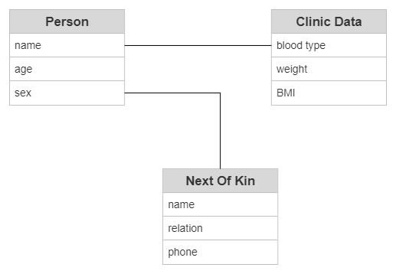
ERD
1
1
1
1

